Slide 1
Requirement Analysis and Specification Document
Plamen Pasliev – 898793
Victor Álvaro Gonzalez - 897700

Slide 2
Scope of the project
Calendar-based application
Filled with appointments and breaks
Assists the user in routing (duration, location, weather, availability)

Slide 3
What are the goals of the system?
[G1] Allow a User to manage appointments.
[G2] Allow a User to specify their own travel preferences.
[G3] Allow a User to introduce the breaks that he requires during the day and the temporal range in which he wants to do the rest.
[G4] User should receive alerts.
[G5] The user should receive directions from his current location to the location of the event.
[G6] The system must consider days in which the public transport or the transport chosen by the user is not available or delayed.
[G7] The system must consider the weather when an event takes place.

Slide 4
Use case – User creating an event
ACTORS | User
GOALS | [G1]
INPUT CONDITIONS | There are no entry conditions.
EVENTS FLOW | The user should press the “Calendar” bottom. The user should press the “Add event” button. The user should enter a title for the event. The user should enter a start time for the event. The user should enter an end time for the event. The user should enter his location before the event (start location). The user should enter the location of the event (end location). The user should press the “Save” button.
OUTPUT CONDITIONS | The appointment is added to the calendar.
EXCEPTIONS | 1. The user inserts a non-existing location. This exception is handled notifying the issue to the User and taking back the Event Flow to the point 6. 2. The user inserts an event that overlaps with another one. This exception is handled notifying the issue to the User and taking back the Event Flow to the point 4.

Slide 5
What are the most important three to five requirements?
Allow the user to place an event (meeting or break) in his agenda.
The system must be able to calculate the estimated travel time to reach the meeting.
Obtain different routes (at least one) between the events taking into account the travel preferences of the user.
Notify the user if there is an event overlap.
The system must be able to check the availability of transport methods at a given location.

Slide 6
What are the most important assumptions?
Constant internet connectivity.
Geolocation turn on at all times.
User correctly enters meeting adress.
The phone is synchronized correctly with the current time of the user region via mobile link or manually.

Slide 7

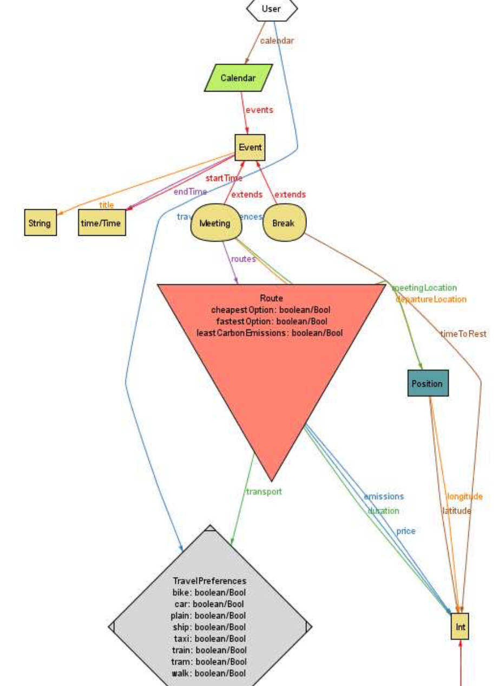
What do you aim to analyse and prove through the Alloy model?
We tried to verify that events(meetings and breaks) are created without overlapping and that they can also be deleted.

